Slide 1
-Smart and complete solutions for parenting-

Slide 2
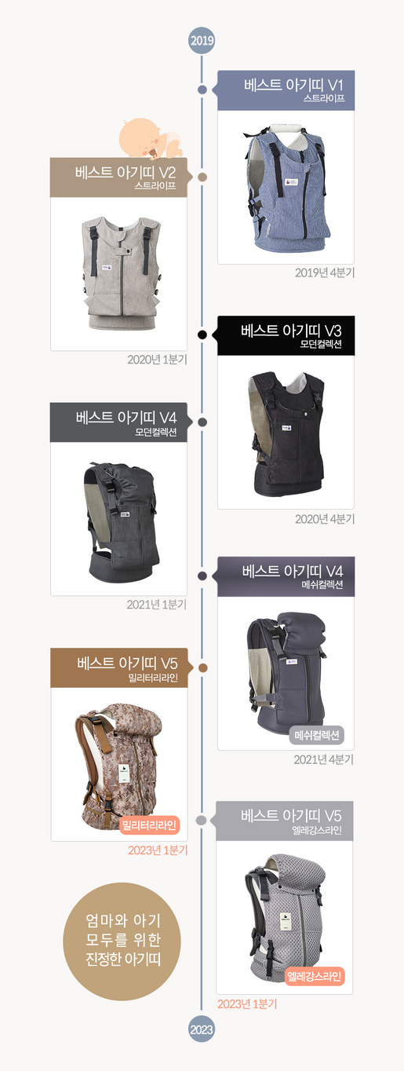

Company History
2019 Founded in September
2020 Launched the world’s first vest-style baby carrier in 2020 Won the Gold Prize at the Women Inventors Expo in
2020 Received the Minister of Gender Equality and Family Award in
2024Awarded the Korea Consumer Brand Award in 2024 Began exports to Japan in
2024 Korea Brand Award – 1st Place 2025 KCBI Korea Consumer Award 2025 Established Bebeswan Co., Ltd.
2026 U.S. Market Entry Contract Confirmed
2026 Q1 Scheduled Launch of Premium New Product “Eternity”

Slide 3
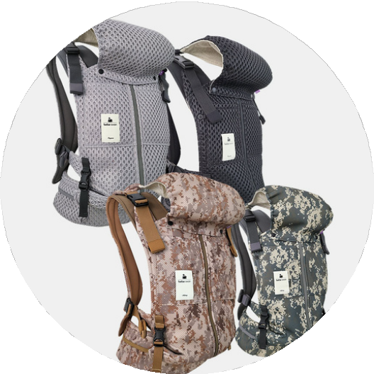
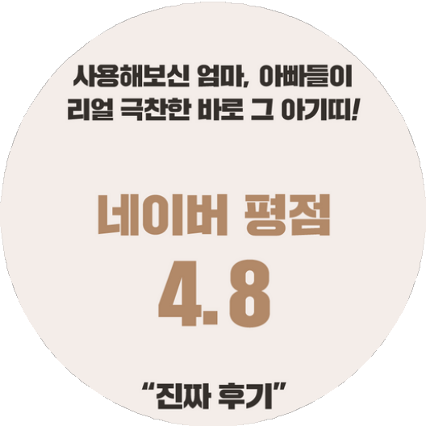
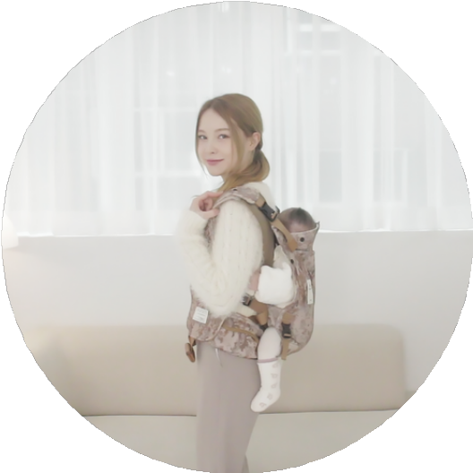
Business Value
Business Vision
Potential Assessment
Meeting the Needs of Parents
World's First Vest-type Baby Carrier
Design Registration Patent Registration
A Baby Carrier Receiving Great Praise!
A Baby Carrier Praised Highly by Real Users!
A Baby Carrier that Protects Your Shoulders and Waist, and Allows You to Easily Carry Your Baby on Your Own

Slide 4
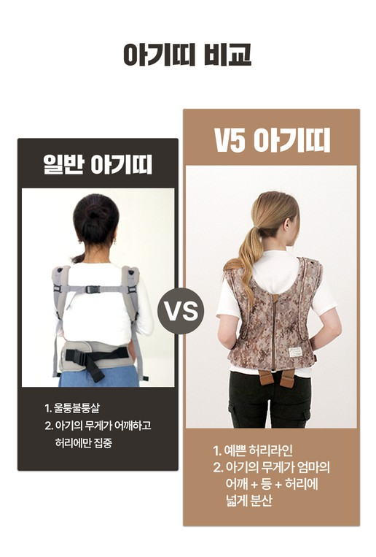
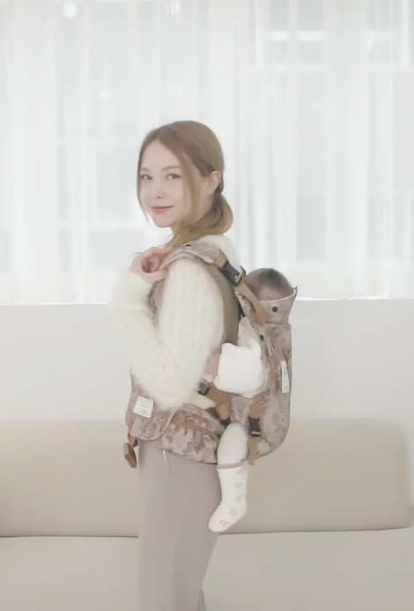
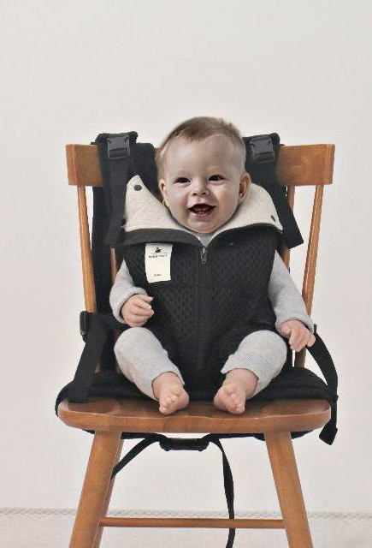
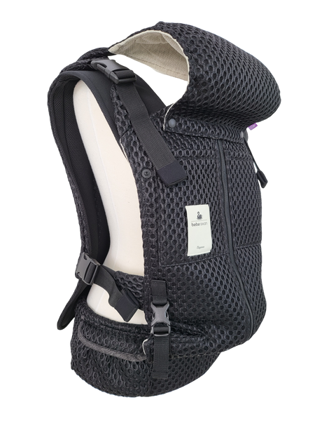
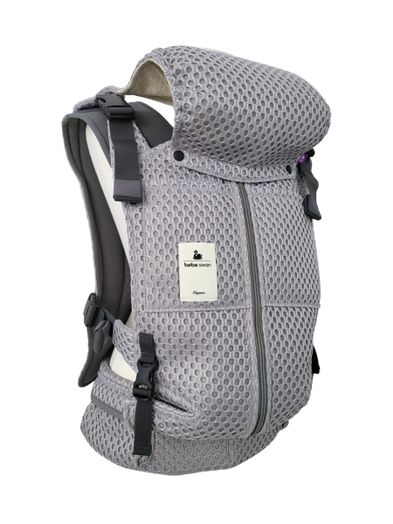
World's First Vest-type
01
Baby Carrier!
6 Key Benefits(1~3)
-Just having a comfortable baby carrier makes parenting so much easier!-
A Baby Carrier that is Comfortable for Shoulders and Waist
The vest-type baby carrier distributes the baby’s weight evenly across the mother's
<shoulders + back + waist>, making it comfortable even for extended use
A Baby Carrier You Can Use to Carry Your Baby on Your Own
Most moms are handling childcare alone during the day when their husbands go to work. If you can carry your baby easily on your own, you don’t have to give up on either parenting or household chores
A Baby Carrier that Transforms into a Booster
When you visit your in-laws or your parents' house, you might have struggled to enjoy a comfortable conversation while holding your baby during meals. Now, with just a vest-type baby carrier, meal times will turn into a comfortable and enjoyable experience

Slide 5
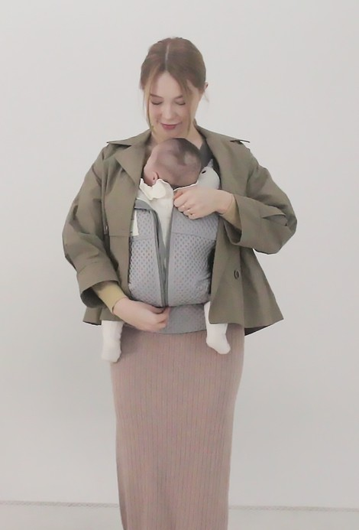
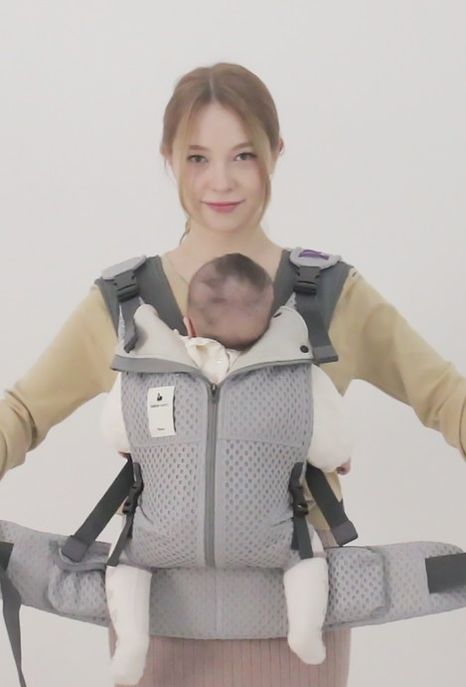
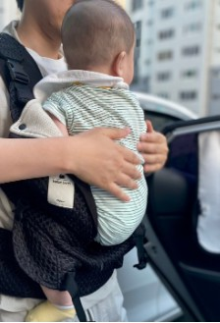
World's First Vest-type Baby Carrier!
6 Key Benefits (4-6)
02
-Just having a comfortable baby carrier makes parenting so much easier!-
The convenience of easily lifting and putting down your baby!
You don’t need to take off your outerwear, undo the buckle on your back, or lower the shoulder straps! Just zip down and you can easily lift and put down your baby!
A Vest-type Baby Carrier that Makes Using the Restroom Convenient!
E v e n i f y o u u n d o th e w a i s t
b e l t , th e b a b y s ta y s s e c u r e ly in p la c e w i th th e v e s t - ty p e
b a b y c a r r ie r , m a k in g i t
c o n v e n ie n t to ta k e o f f a n d
p u t o n y o u r p a n ts w h e n u s in g th e r e s t r o o m !
A Vest-type Baby
Carrier That Can Be
Easily Transferred to
a Car or Stroller!
Just zip down, put your baby
in the car, and you can drive right away without having to remove the baby carrier or store it separately—wearing it comfortably as is!

Slide 6
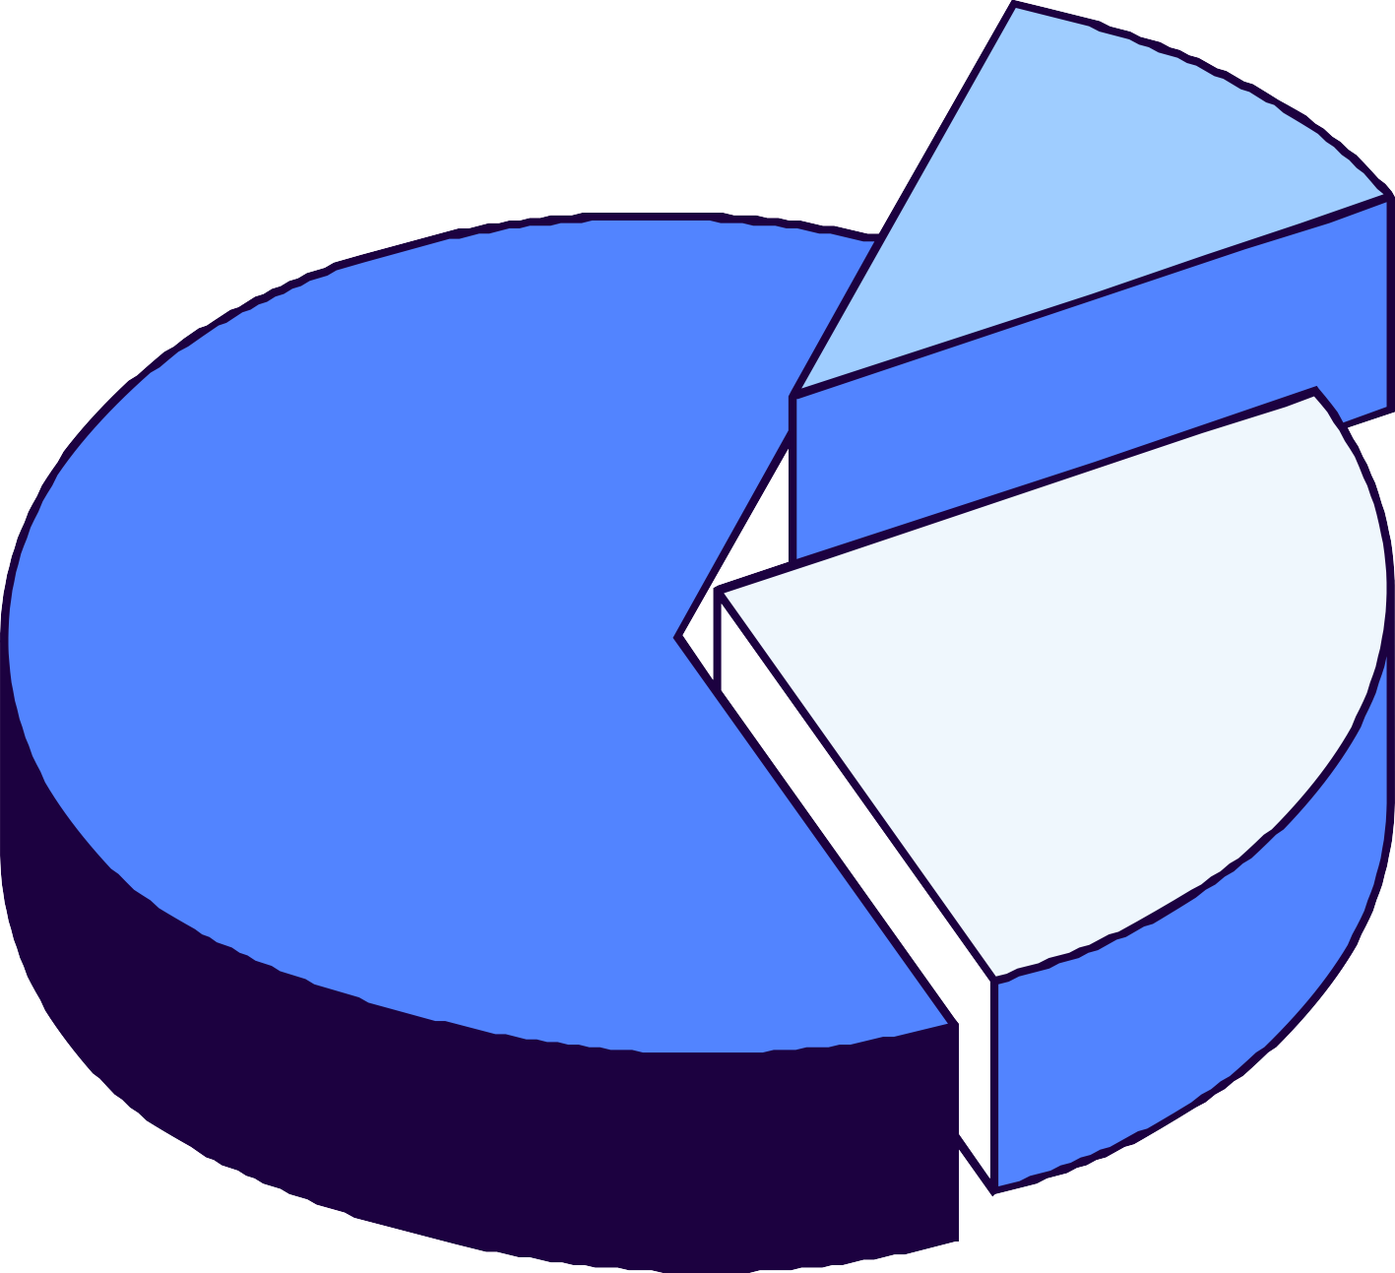
Satisfaction of Parents Using Other
Brands of
Baby Carriers
10%
"Over 70% of users report shoulder and back pain.
Over 20% of users complain about the weight and discomfort.
Only over 10% of users are satisfied.
70%
20%
# This information is based on a statistical analysis of 100 baby carrier users at the 2022 COEX Baby Fair.

Slide 7
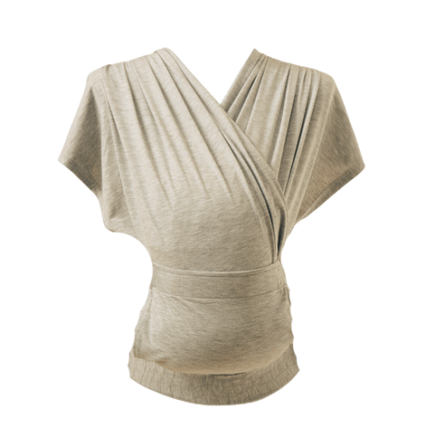
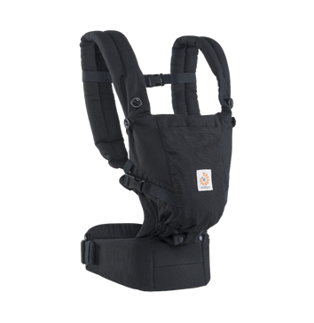
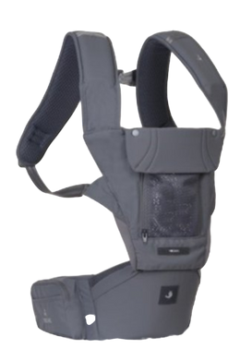
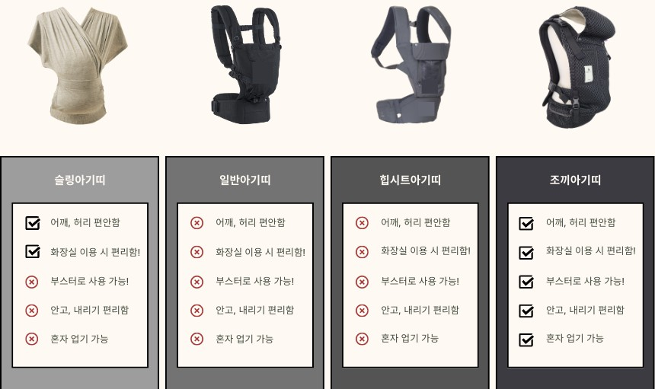


Our Company vs Competitor
Model Comparison
SLING BABY CARRIER
STANDARD BABY CARRIER
HIP SEAT BABY CARRIER
VEST-TYPE BABY CARRIER
Comfort for Shoulders and Waist
Convenience When Using the Restroom!
Cannot Be Used as a Booster
Difficult to Lift and Put Down
Cannot Be Carried on Your Own
D i s c o m f o r t i n S h o u l d e r s a n d W a i s t
Discomfort When Using the Restroom
Cannot Be Used as a Booster
Difficult to Lift and Put Down
Cannot Be Carried on Your Own
D i s c o m f o r t i n S h o u l d e r s a n d W a i s t
Comfort for Shoulders and Waist
Convenience When Using the Restroom!
Can Be Used as a Booster!
Easy to Lift and Put Down
Can Be Worn Alone
Discomfort When Using the Restroom
Cannot Be Used as a Booster
Difficult to Lift and Put Down
Cannot Be Carried on Your Own

Slide 8


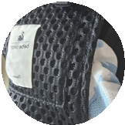



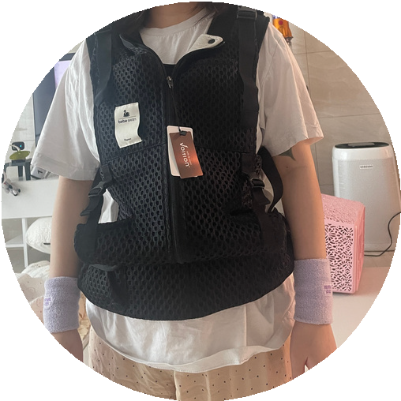
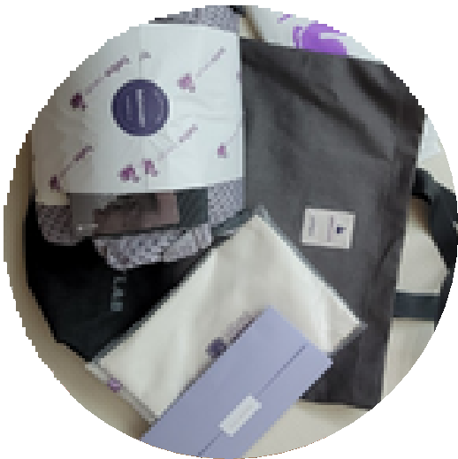
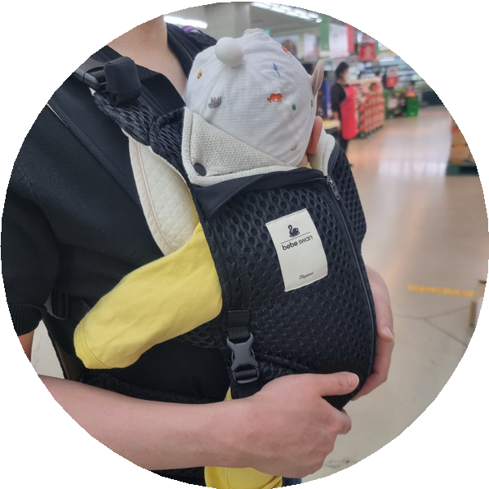
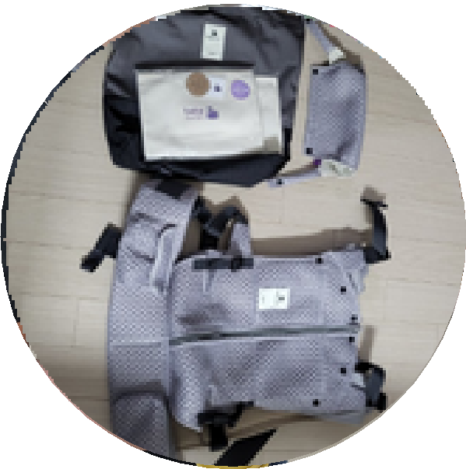
VEST-TYPE BABY CARRIER
REAL REVIEWS
aman****
I was using a newborn baby carrier, but my back started hurting, so I looked for other carriers and decided to buy this one, trusting the free return policy. First of all, my baby seems comfortable, and neither my husband nor I have any back pain, so I regret not buying it sooner!
kinm***
My baby seems comfortable and sleeps well! And when I need to put my baby down while sleeping, it's so convenient to just unzip and take the baby out.
With the previous baby carriers, I had to struggle
with unbuckling the straps on the back... I managed to lay my baby down, but the sound of the Velcro would wake them up! I still have the hip seat baby carrier and the sling carrier from when I had my first child, but for now, I think I'll be reaching for the vest-type baby carrier the most!
FROM CUSTOMERS!
RATING: 4.8
mins*****
I've found the most comfortable baby carrier! When I was taking care of my nephews and nieces, I used a hip seat carrier, but after wearing it for a long time, my back and shoulders would hurt so much. This one is a vest-type, so the weight is distributed, and it's so comfortable! It's even better than I expected!
bm****
This is a baby carrier that is comfortable for both the baby and the parents! I bought it because my baby developed a rash on the bottom while using the hip seat carrier. I wish I had known about this sooner. I’ll use it well!
on****
I was using another baby carrier, but I bought the Bebe Swan baby carrier because my husband has a herniated disc. There weren’t many reviews, so I was a bit skeptical, but he says it’s much easier on his back when carrying the baby! We've been using it for two weeks now, and my baby has no issues being held and sleeps well. We're very happy with it!
khj1******
My husband strongly recommended that we get this, so I bought it. Haha, my baby quickly got used to it and falls into a deep sleep, which makes me feel more comfortable too! I’ll need to wear it a bit longer, but so far, I’m very satisfied!!
The Vest-type Baby Carrier Praised by Real Buyers!

Slide 9
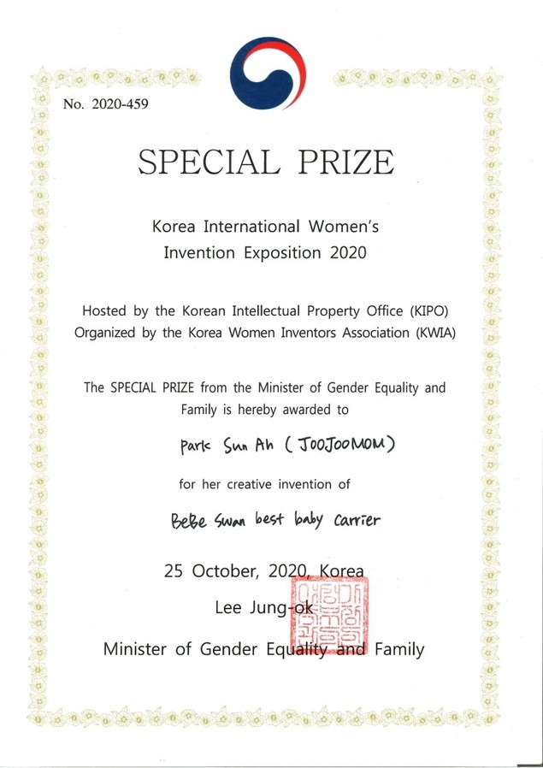
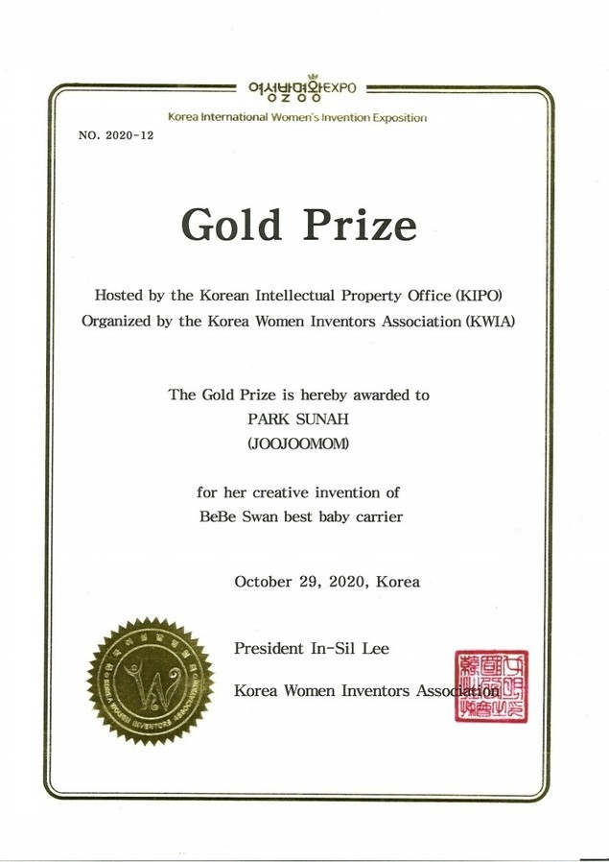
Award-winning
Won the Gold Medal at the World Expo
Won the Minister of Gender Equality and Family Award
Won the Minister of Gender Equality and Family Award
Won the Gold Medal at the World Expo

Slide 10
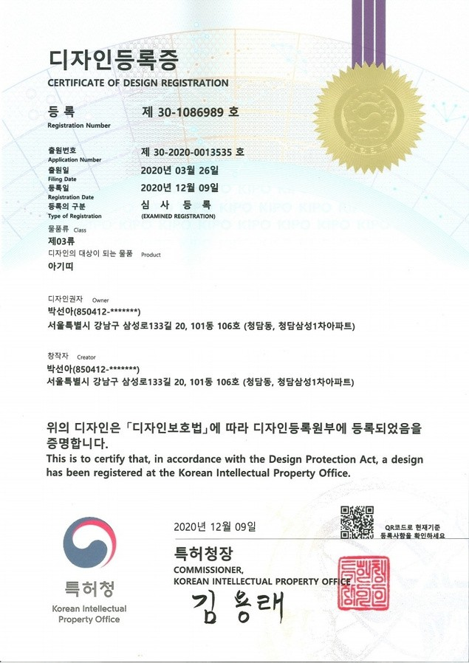
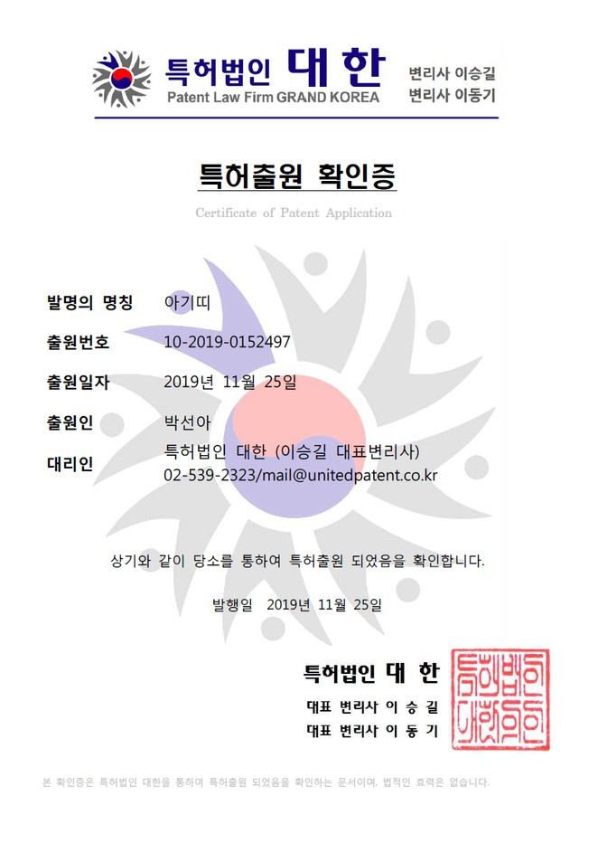
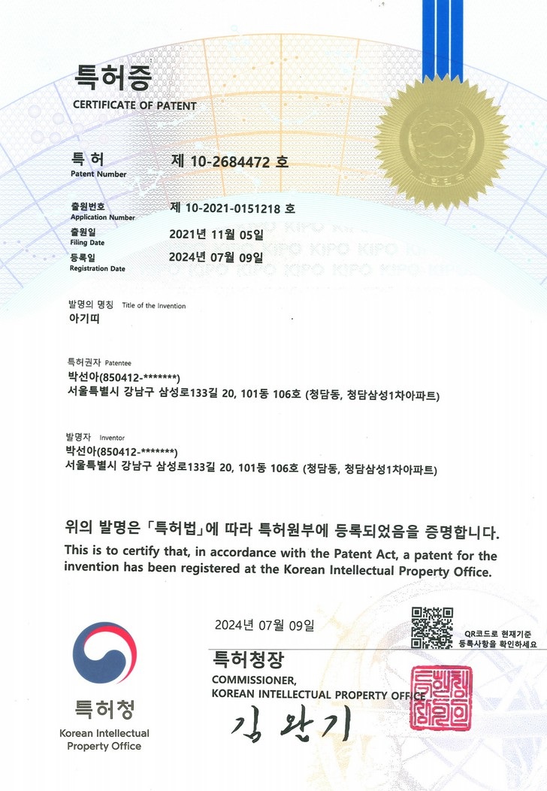
Patent
Design Patent Technology Patent
Design Patent Registration
Technology Patent Registration

Slide 11
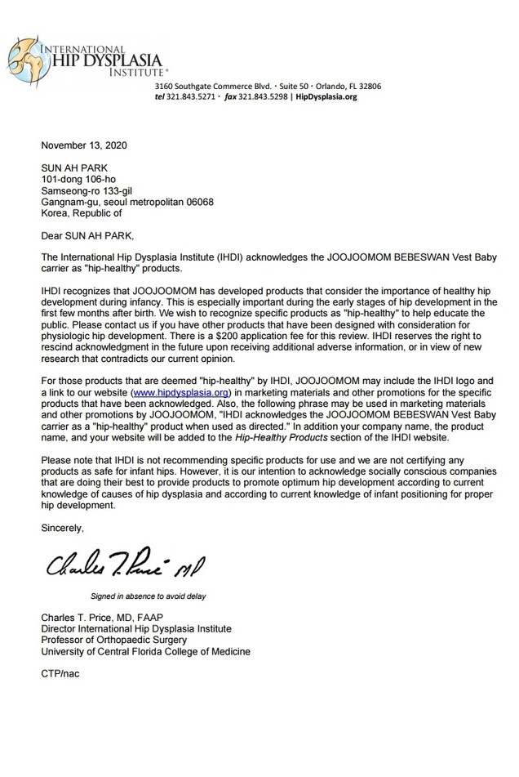
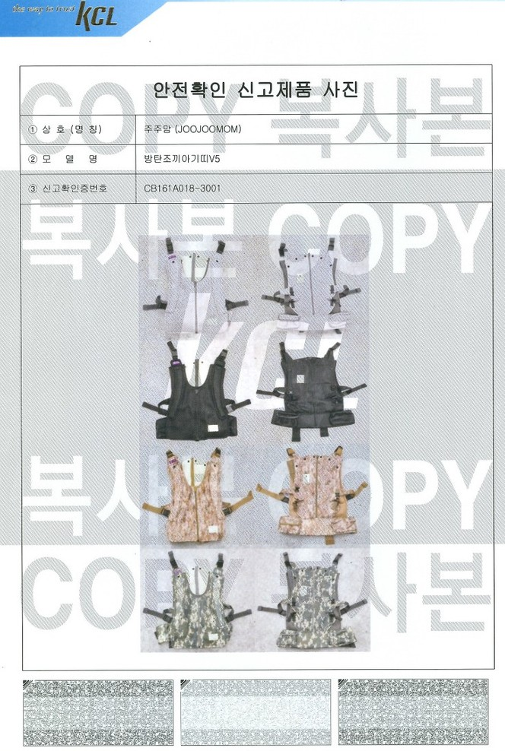
Product Certification
International Hip Joint Association Safety Certification
Korea Certification (KC) Safety Mark
International Hip Joint Association Certification
Korea Certification (KC) Safety Mark

Slide 12
MOQ
UNIT PRICE
Product | Regular price | MOQ 40 units | MOQ 50~500 | MOQ 501~2000 | MOQ 2001~5000
V5 Vest Baby Carrier | $195 | $93 | $87 | $80 | $76
For orders up to 100 units: 100% prepayment is required at the time of order.
For orders over 100 units: 70% prepayment upon order, and the remaining 30% after shipment.

Slide 13
THANK YOU
감사합니다

